Slide 1
Executive Decision Report
Online Retail Business Intelligence Analysis
Executive-ready synthesis of revenue, order, customer, product and geographic performance.
Prepared by: Mohammad Jubaid
1

Slide 2
Executive Summary
Dashboard baseline
Total Revenue
9,747,747.93
Total Orders
25,900
Total Customers
4,373
Total Quantity
5,176,450
AOV
376.36
• The dashboard consolidates core sales KPIs into one executive view.
• Product analysis highlights the highest-revenue items in the displayed Top 10 view.
• Country mapping provides a geographic view of revenue concentration.
• CAC and Churn Rate are not directly measurable from the available transaction fields.
2

Slide 3
Business Objective & Scope
Objective
Analytical scope
Decision lens
Understand retail sales performance, identify
revenue drivers and support data-informed
decisions.
Revenue, orders, customers, quantity, AOV,
time trend, Top 10 products and country
revenue.
Translate measured findings into product, customer/ order and market actions without inventing unavailable cost metrics.
3

Slide 4
Methodology
Transaction data to executive dashboard
1
2
3
4
5
Load & inspect
Online Retail transaction
data
Create revenue
Quantity × UnitPrice
Build KPIs
Revenue, Orders, Customers
, Quantity, AOV
Visualize
Trend, Top Products, Country
Map
Interpret
Drivers, risks, actions
Metric note
The measured KPIs use fields available in the transaction dataset; cost-based KPIs require additional data.
4

Slide 5
Executive KPI Performance
Values shown in the final Power BI dashboard
Total Revenue
9,747,747.93
Total Orders
25,900
Total Customers
4,373
Total Quantity
5,176,450
AOV
376.36
Executive readout
These metrics establish the current sales baseline for future monitoring.
5

Slide 6
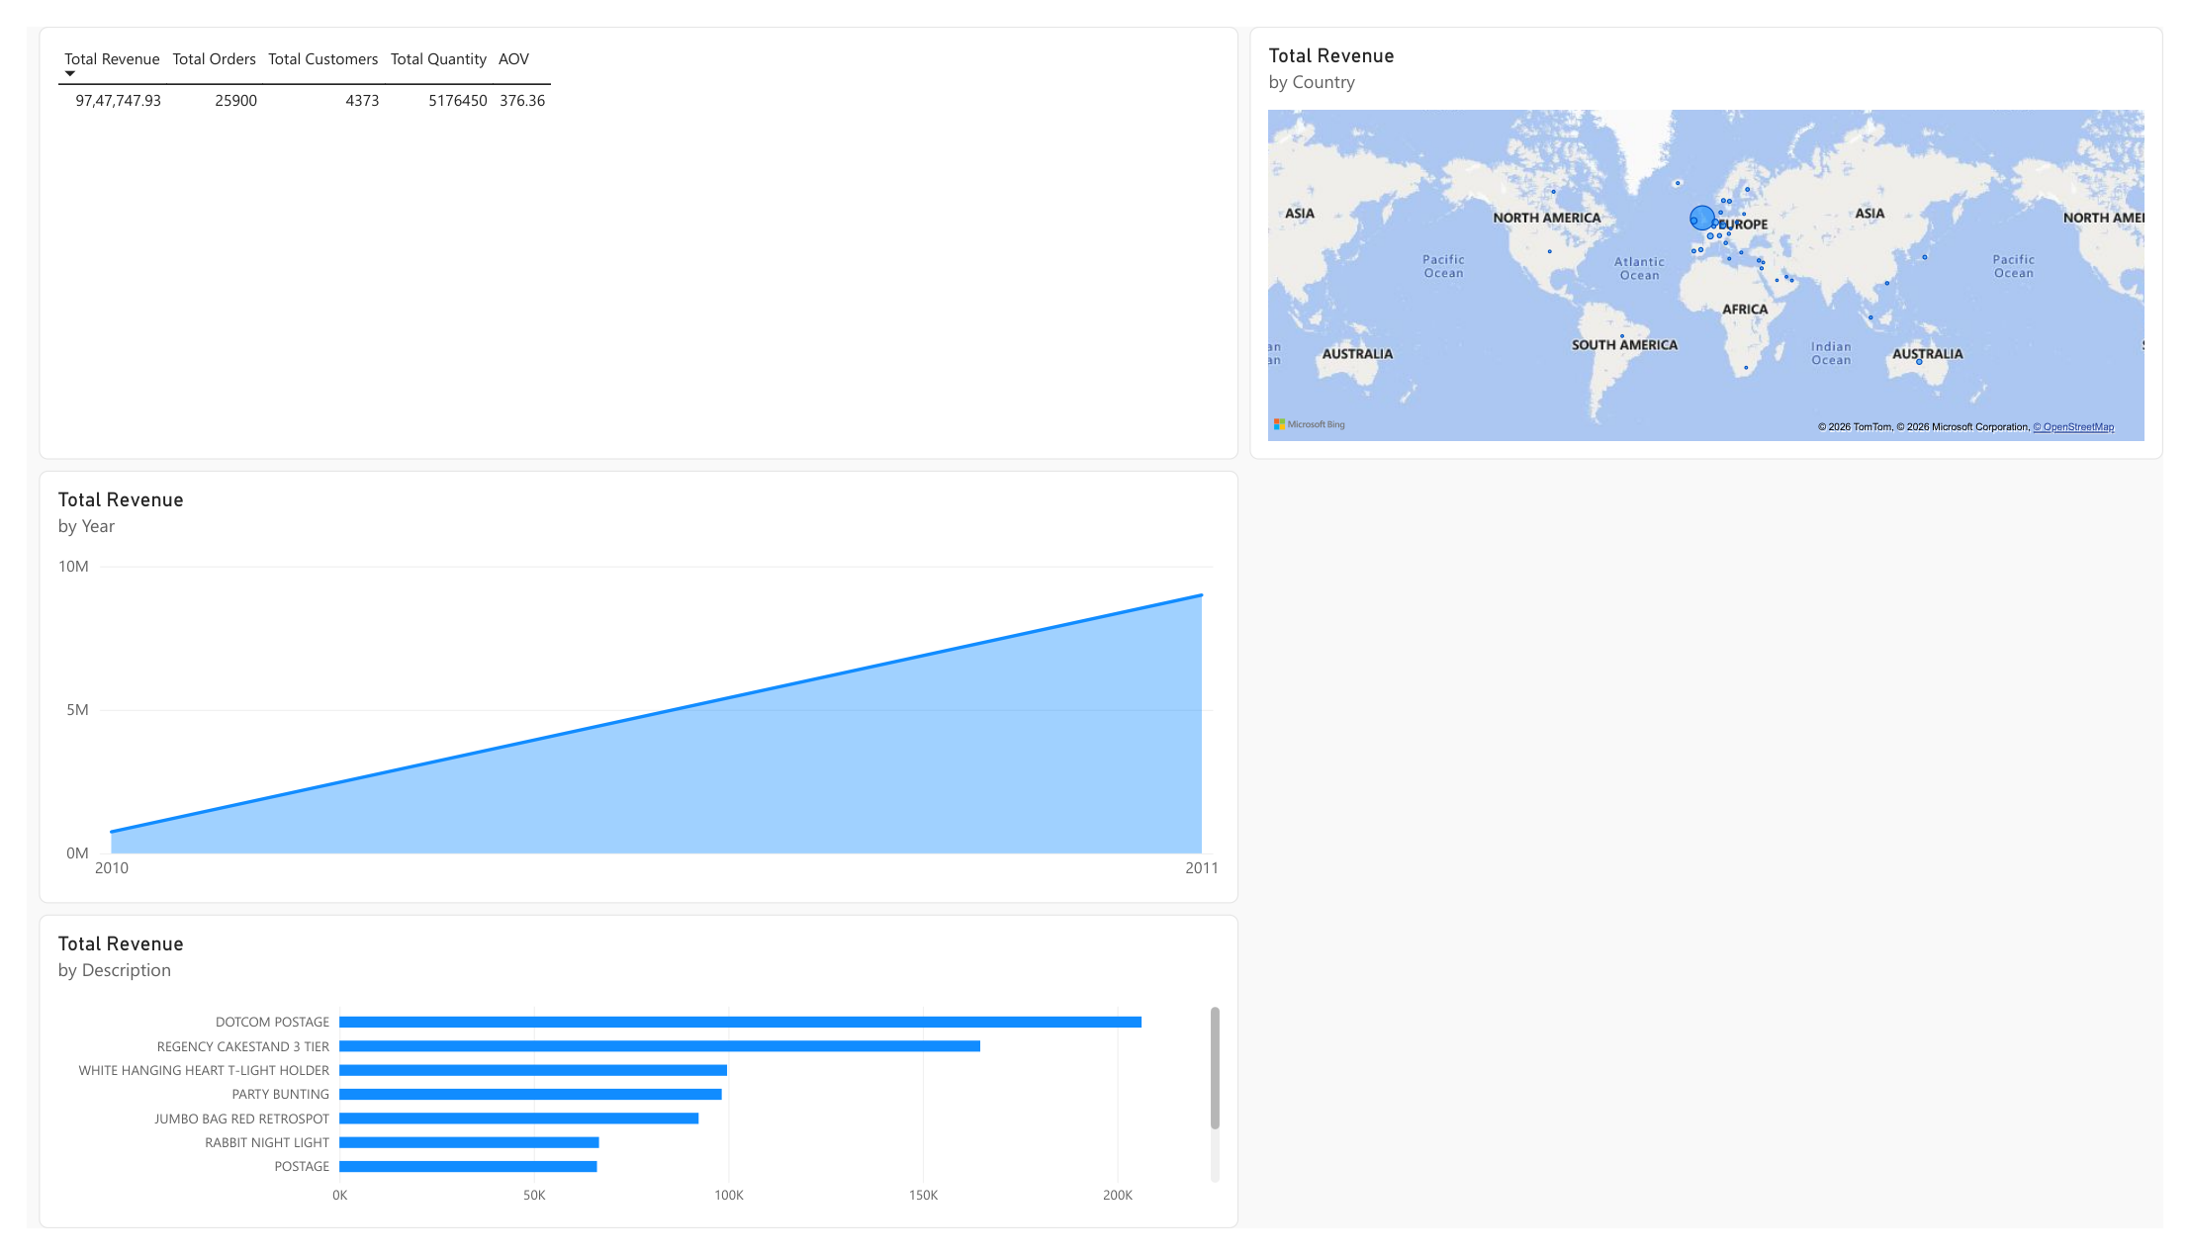
Revenue Trend
Time-based revenue view
What is shown
The dashboard displays Total Revenue by Year for 2010 and
2011.
Decision use
Use the trend to identify stronger/weaker periods and relate them to product and market activity.
Next refinement
Monthly drill-down can provide a more granular view
when required.
6

Slide 7
Key Revenue Drivers
Top products visible in the dashboard
1. DOTCOM POSTAGE
Implication
2. REGENCY CAKESTAND 3 TIER
High-revenue products merit focused
inventory availability and product-level
performance review.
3. WHITE HANGING HEART T-LIGHT HOLDER
4. PARTY BUNTING
5. JUMBO BAG RED RETROSPOT
Evidence note
6. RABBIT NIGHT LIGHT
Product names and ordering are taken from
the dashboard's Top Products view.
7. POSTAGE
7

Slide 8
Geographic Revenue Performance
Country-level revenue map
What the map adds
A geographic view helps identify where revenue
activity is concentrated.
Decision use
Compare country revenue with product mix, orders
and customers before allocating additional resources.
Guardrail
Revenue concentration is not the same as profitability.
8

Slide 9
Risk Areas & Data Limitations
Transaction treatment
Customer completeness
Negative quantities/values can reflect returns or cancellations and should be
reviewed before final revenue decisions.
Missing CustomerID values limit customer-level analysis.
CAC unavailable
Churn unavailable
No acquisition-cost field is provided, so CAC is not a measured KPI in this dashboard.
No explicit churn/retention status is provided, so Churn Rate is not directly
measurable.
9

Slide 10
Strategic Recommendation 1 — Product Focus
Action
Why
Measure
Prioritize monitoring of high-revenue products and
protect availability through focused inventory
review.
The Top Products view identifies items that appear
prominently in the revenue ranking.
Track product revenue, order quantity and stock-out/
availability indicators after implementation.
10

Slide 11
Strategic Recommendation 2 — Customer & Order Value
• Segment customers using CustomerID-linked transaction history.
• Identify high-value customer groups and examine repeat-order behavior.
• Test bundles or targeted offers designed to increase order value.
• Monitor AOV and order frequency as primary outcomes.
Baseline
Current AOV: 376.36.
Data requirement
Retention/churn and campaign-cost fields are needed to
quantify customer ROI.
11

Slide 12
Strategic Recommendation 3 — Market Optimization
• Use the country revenue map to identify markets with meaningful sales activity.
• Compare market revenue with product mix and order volume before expanding investment.
• Prioritize deeper analysis where revenue, customers and product demand align.
Decision input
Country revenue distribution from the Power BI map.
Guardrail
Do not treat revenue alone as profitability or market
attractiveness.
12

Slide 13
ROI Framework & Implementation Timeline
ROI framework
Week 1
A defensible numerical ROI projection requires implementation cost plus
incremental revenue/profit and campaign or operating costs. Those cost fields
are not present in the current dataset.
Validate transaction treatment and product performance.
Week 2
Run customer/order-value segmentation and define tests.
Week 3
Review country performance and select markets for deeper analysis.
Week 4+
Implement pilots and monitor revenue, orders and AOV.
13

Slide 14
Executive Decision Summary
• Use the Power BI dashboard as the baseline monitoring view for revenue, orders, customers, quantity and AOV.
• Focus operational attention on products prominent in the Top Revenue ranking.
• Use country-level revenue patterns to guide deeper market analysis.
• Add acquisition-cost, retention/churn and profitability data before making CAC, churn or numerical ROI claims.
Next data priority
Connect marketing cost, retention and profit/cost data to the existing dashboard.
14

Slide 15
Analytics Portfolio Deliverables
• Executive Decision Report — presentation
• Power BI Online Retail Dashboard — .pbix
• Dashboard PDF export
• Final Analytical Jupyter Notebook — .ipynb
Prepared for mentor evaluation
15

